Slide 1


Traffic Sensor Data
Institute for Transportation

Slide 2
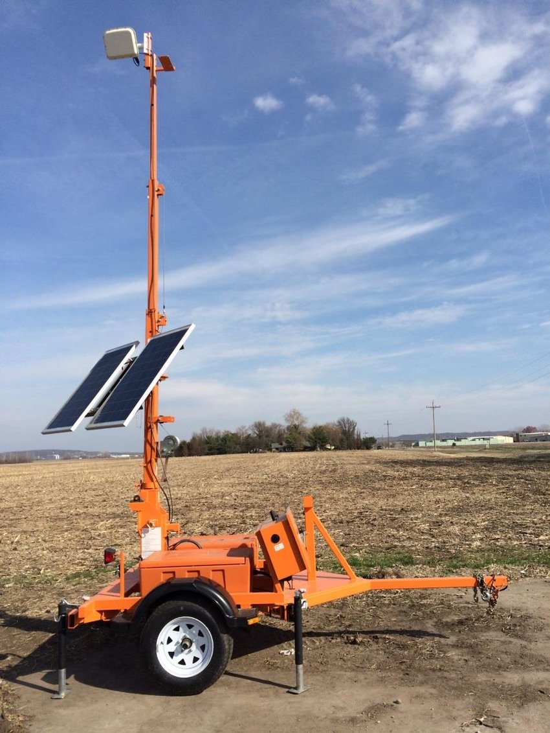
Wavetronix Smart Sensors
Radar to collect vehicle data
Mainly traffic volume
Counts vehicles in each lane at sample period
Classification
Average speed by lane
Occupancy

Slide 3
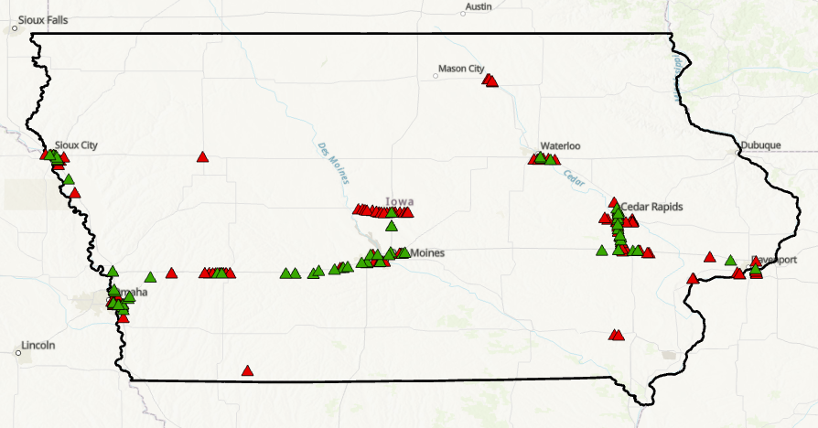
Deployment
More than 300 sensors
Mainly covering urban areas
For traffic management

Slide 4
Data
owner-id | network-id | date | time | utc-offset | start-ime | end-time | detector-id | status | lane-id | lane-count | lane-occupancy | lane-speed
Q-Free | Q-Free | 20000102 | 134700 | 0 | 134600 | 134700 | CRDS19- SB RL | OK | 1 | 1 | 0 | 44
Q-Free | Q-Free | 20000102 | 134700 | 0 | 134600 | 134700 | CRDS19- SB CL | OK | 2 | 2 | 0 | 43
Q-Free | Q-Free | 20000102 | 134700 | 0 | 134600 | 134700 | CRDS19- SB LL | OK | 3 | 1 | 0 | 31
Q-Free | Q-Free | 20000102 | 134700 | 0 | 134600 | 134700 | CRDS19- NB LL | OK | 4 | 0 | 0 | 56
Q-Free | Q-Free | 20000102 | 134700 | 0 | 134600 | 134700 | CRDS19- NB CL | OK | 5 | 2 | 1 | 46
Q-Free | Q-Free | 20000102 | 134700 | 0 | 134600 | 134700 | CRDS19- NB RL | OK | 6 | 0 | 0 | 55
Q-Free | Q-Free | 20000102 | 114700 | 0 | 114600 | 114700 | CRDS19- SB RL | OK | 1 | 2 | 0 | 52
Q-Free | Q-Free | 20000102 | 114700 | 0 | 114600 | 114700 | CRDS19- SB CL | OK | 2 | 0 | 0 | 55
Q-Free | Q-Free | 20000102 | 114700 | 0 | 114600 | 114700 | CRDS19- SB LL | OK | 3 | 0 | 0 | 37
Q-Free | Q-Free | 20000102 | 114700 | 0 | 114600 | 114700 | CRDS19- NB LL | OK | 4 | 0 | 0 | 59
small-class-count | medium-class-count | large-class-count | device-id | link-direction | detector-type | sample-period | device-description | cst-time | month | day
1 | 0 | 0 | OpenTMS-Detector45588-1 | s | unknown | 60 | NORMAL | 2022-11-25-03-18-01 | 11 | 25
2 | 0 | 0 | OpenTMS-Detector45588-2 | s | unknown | 60 | NORMAL | 2022-11-25-03-18-01 | 11 | 25
1 | 0 | 0 | OpenTMS-Detector45588-3 | s | unknown | 60 | NORMAL | 2022-11-25-03-18-01 | 11 | 25
0 | 0 | 0 | OpenTMS-Detector45588-4 | n | unknown | 60 | NORMAL | 2022-11-25-03-18-01 | 11 | 25
1 | 0 | 1 | OpenTMS-Detector45588-5 | n | unknown | 60 | NORMAL | 2022-11-25-03-18-01 | 11 | 25
0 | 0 | 0 | OpenTMS-Detector45588-6 | n | unknown | 60 | NORMAL | 2022-11-25-03-18-01 | 11 | 25
2 | 0 | 0 | OpenTMS-Detector45588-1 | s | unknown | 60 | NORMAL | 2022-11-25-01-17-41 | 11 | 25
0 | 0 | 0 | OpenTMS-Detector45588-2 | s | unknown | 60 | NORMAL | 2022-11-25-01-17-41 | 11 | 25
0 | 0 | 0 | OpenTMS-Detector45588-3 | s | unknown | 60 | NORMAL | 2022-11-25-01-17-41 | 11 | 25
0 | 0 | 0 | OpenTMS-Detector45588-4 | n | unknown | 60 | NORMAL | 2022-11-25-01-17-41 | 11 | 25

Slide 5
Data
Data from POLK County covering Des Moines
November and December 2022
Covering two holiday seasons (Heavy congestion, crashes etc.)
Incorrect Time stamps
Do not have variation in lanes
Some have no data
Challenges

Slide 6
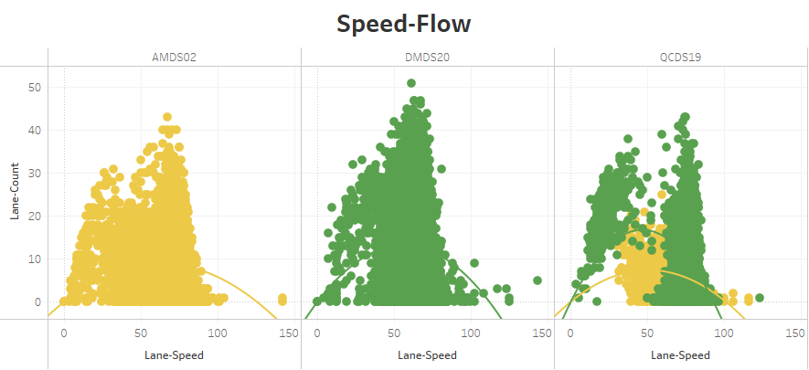
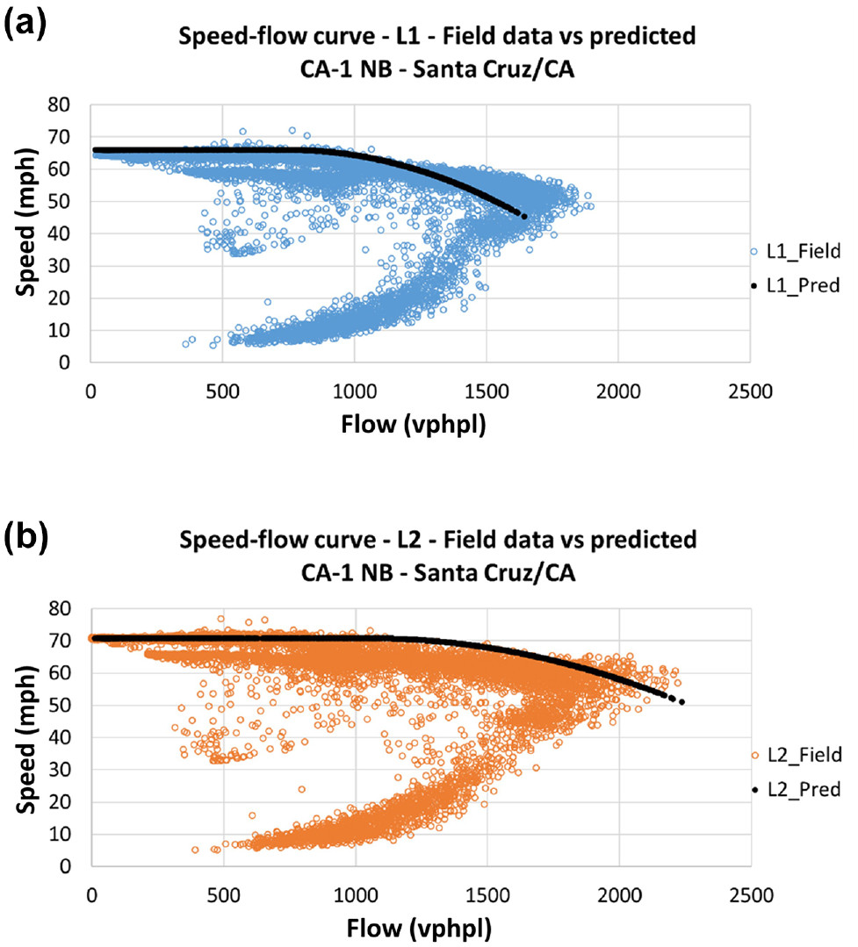
Visualization - 1

Slide 7
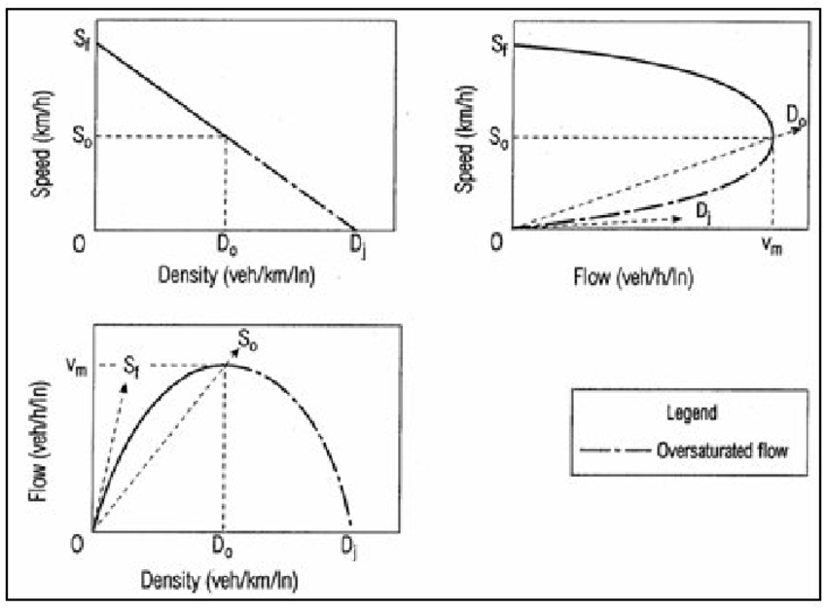
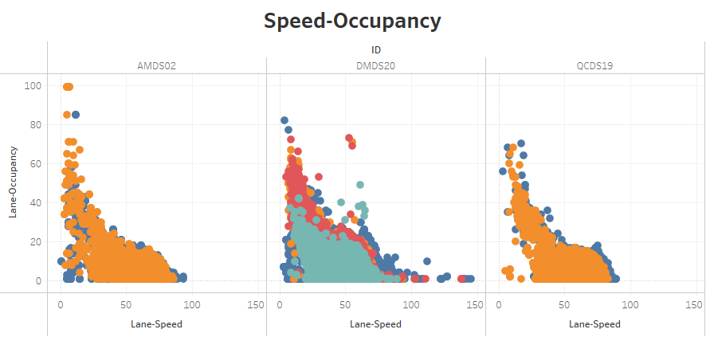
Visualization - 2

Slide 8
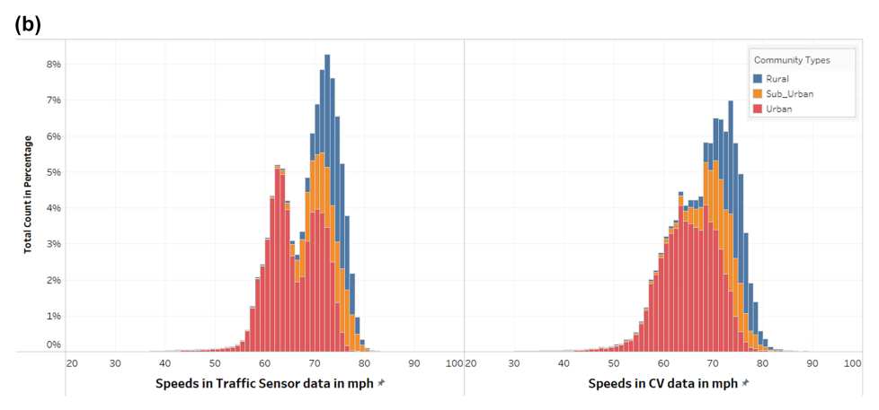
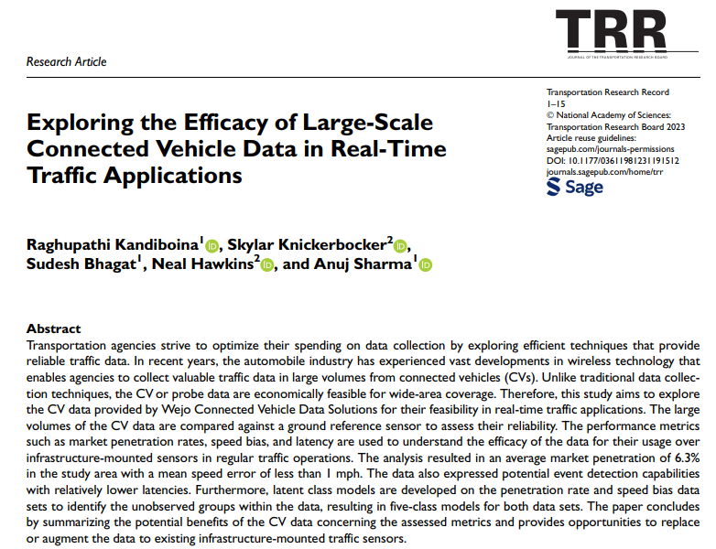
Previous Research - 1

Slide 9
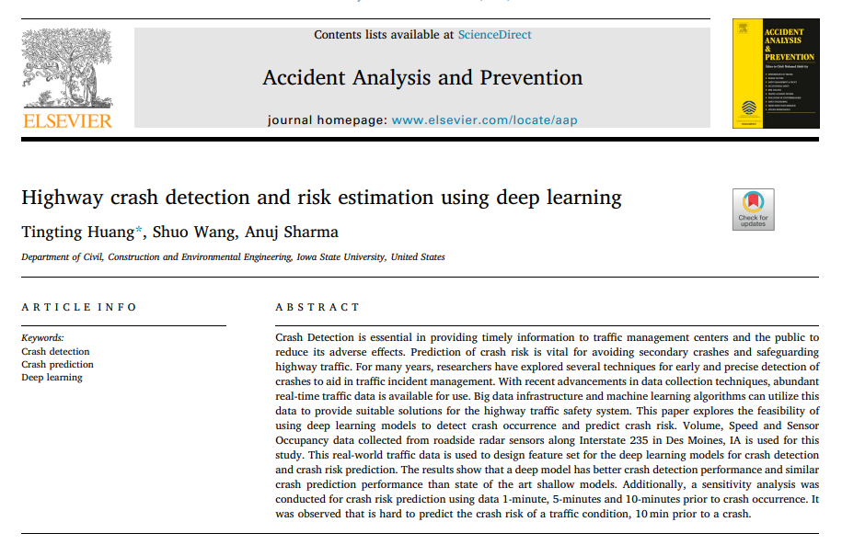
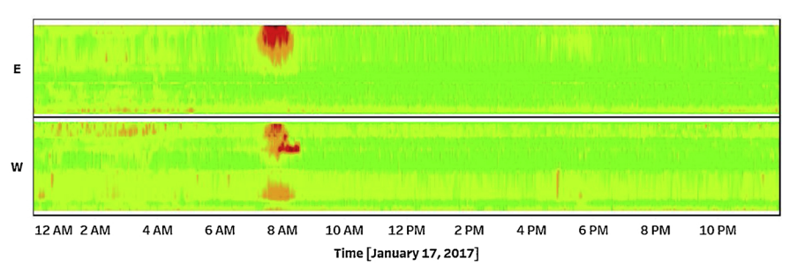
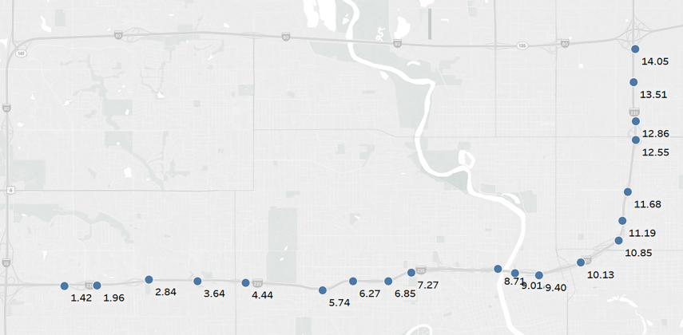
Previous Research - 2

Slide 10
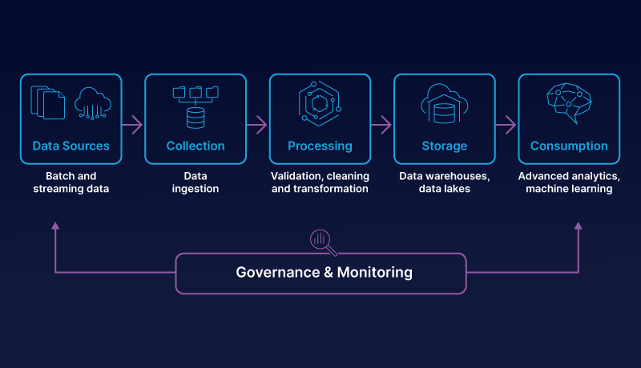
Data Pipeline

Slide 11
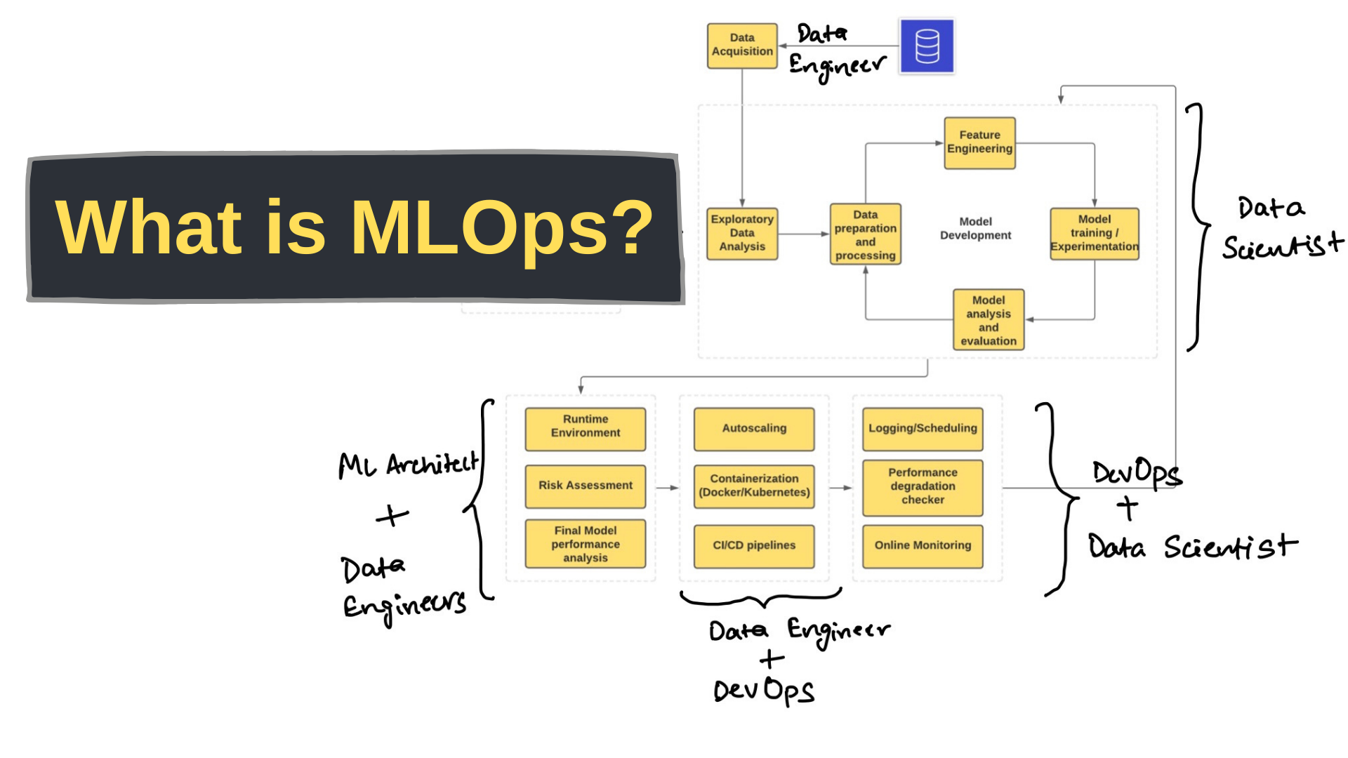

Slide 12
